Slide 1
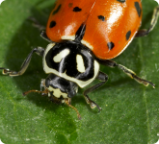
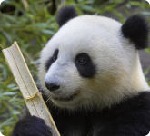
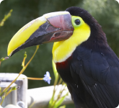
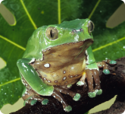
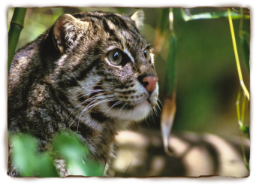
Zoo Animals
By Susie Que
3rd Grade
Mrs. Blank’s Class

Slide 2
Panda
Fact 1
Fact 2
Fact 3

Slide 3
Tree Frog
Fact 1
Fact 2
Fact 3

Slide 4
Girafee
Fact 1
Fact 2
Fact 3

Slide 5
Leopard
Fact 1
Fact 2
Fact 3

