Slide 1
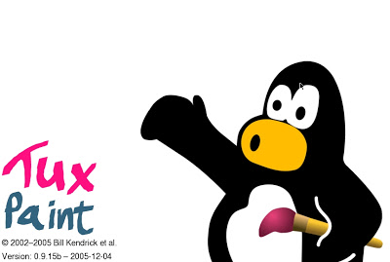
TUX PAINT
INTRODUCTION TO
Graphics Software

Slide 2
What is Tux Paint?
Tux Paint is an interactive paint program. In Tux Paint you are given many tools to explore creativity.

Slide 3
I Will…
Today you will create an original product using Tux Paint.
I will show how to use tools to create and save.

Slide 4
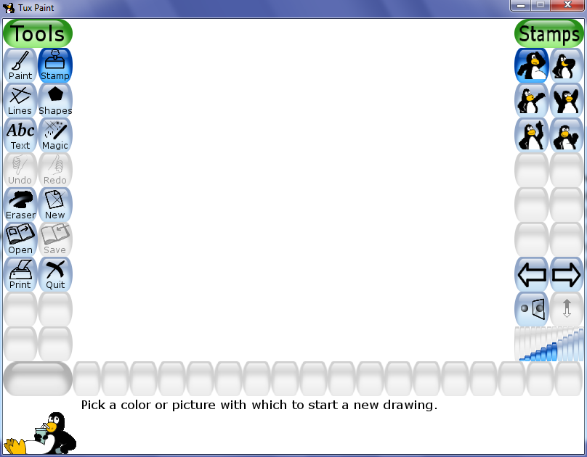
Drawing Area
You will draw in the white space.

Slide 5
Drawing Tools
Click on the tool of your choice to begin drawing.

Slide 6
Tools We’ll Use Today
Click on the tool of your choice to begin drawing.

Slide 7
Very Important Tools
These tools help you to start anew or save your work.

Slide 8
Show What You Know

Slide 9
Which tool do I use if I want to erase a mistake?
Click on the answer

Slide 10
Which tool would you use to save your work?
Click on the answer

Slide 11
Which tool would you use to close Tux Paint?
Click on the answer

Slide 12
Which tool would you use to make a blank paper?
Click on the answer

Slide 13
Which tool would you use to open work that you have saved?
Click on the answer

